Slide 1
Bio& 242:
Unit 2 / Lecture 3

Slide 2
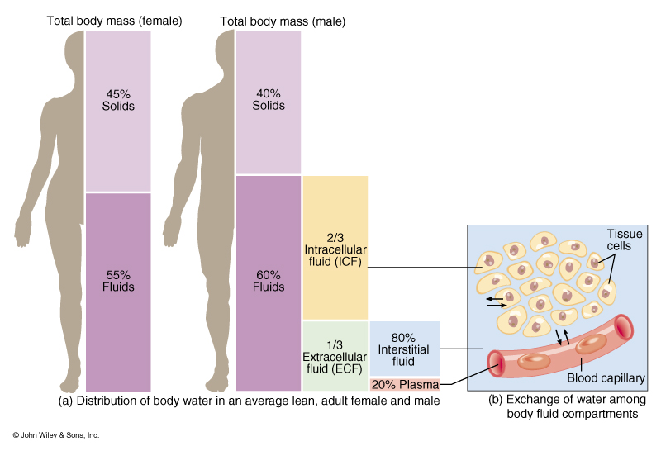
Volume of Body Fluid in the different body compartments

Slide 3
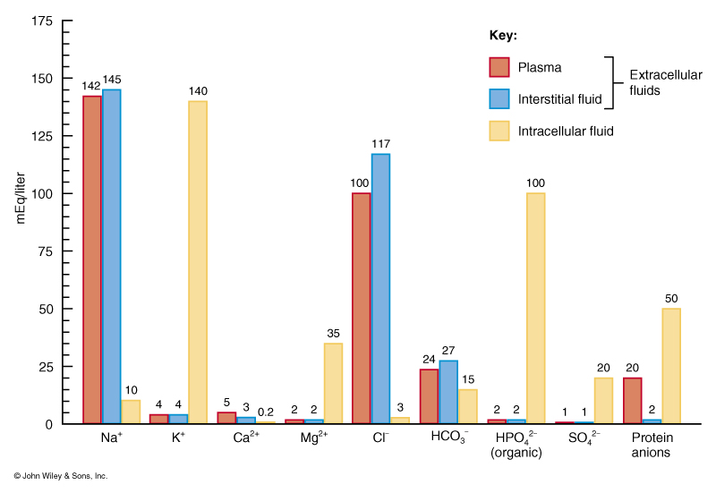
Comparison of Electrolytes in Plasma, Interstitial Fluids and Intracellular Fluids

Slide 4
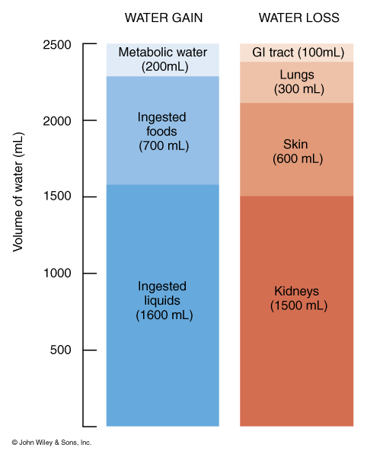
Daily Water Balance
Under Normal Conditions

Slide 5
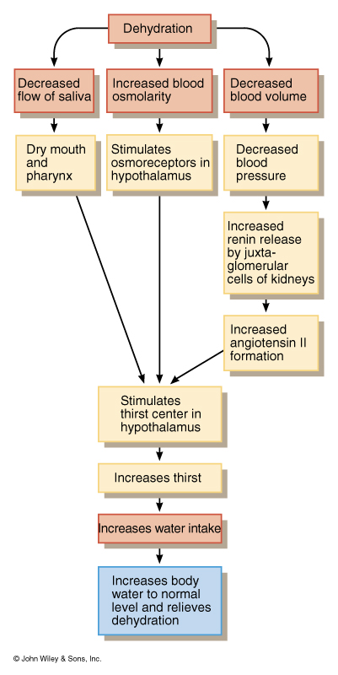
Pathways Through Which Dehydration Stimulates Hypothalamic Thirst Centers

Slide 6
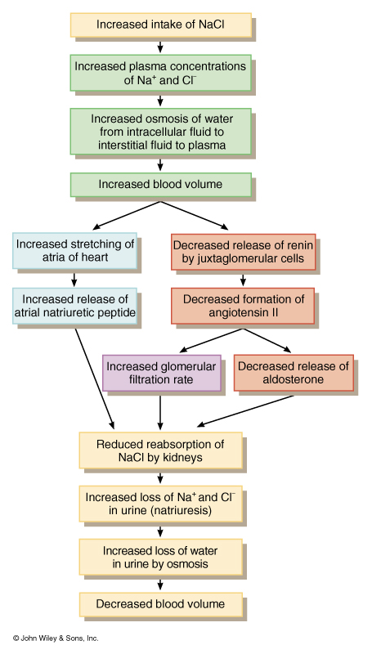
Relationship Between Sodium Intake, Water Balance and Hormones

Slide 7
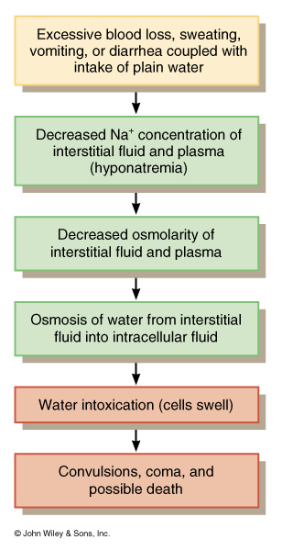
Series of Events in Water Intoxication

Slide 8
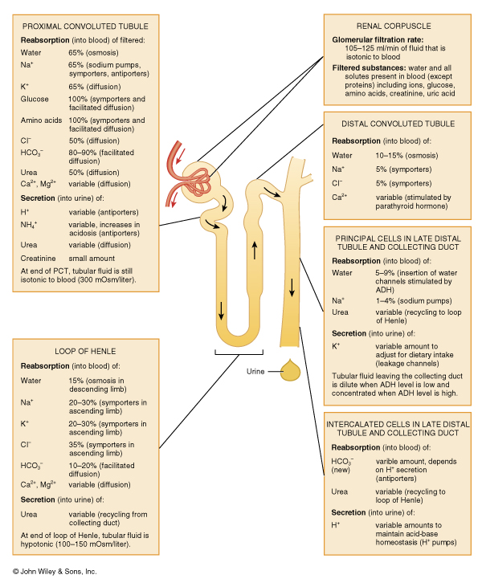
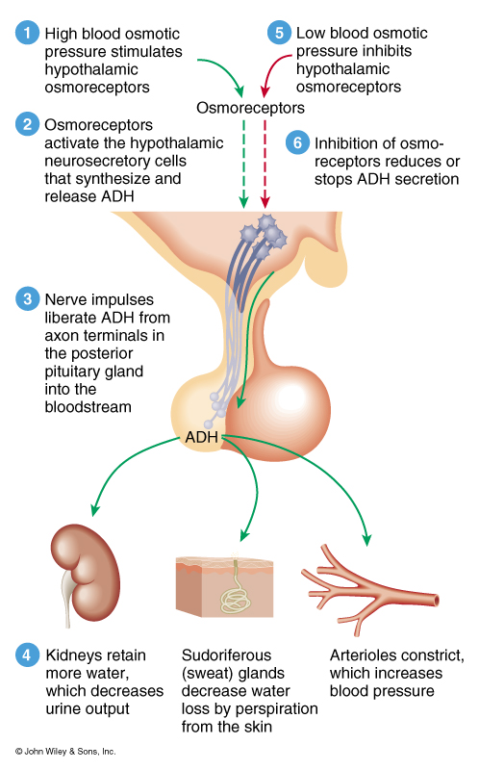
Role of ADH in Water Balance

Slide 9
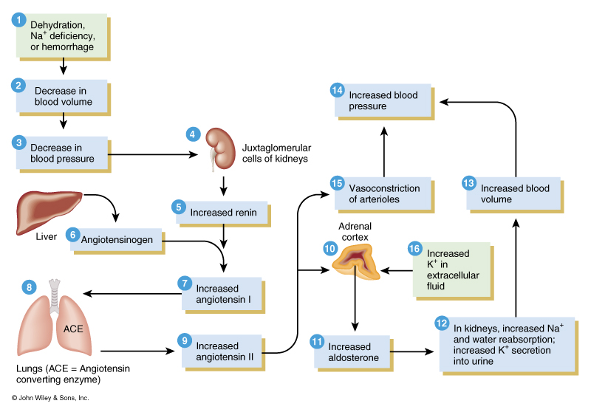
Summary of Hormones Involved in Water Balance

Slide 10
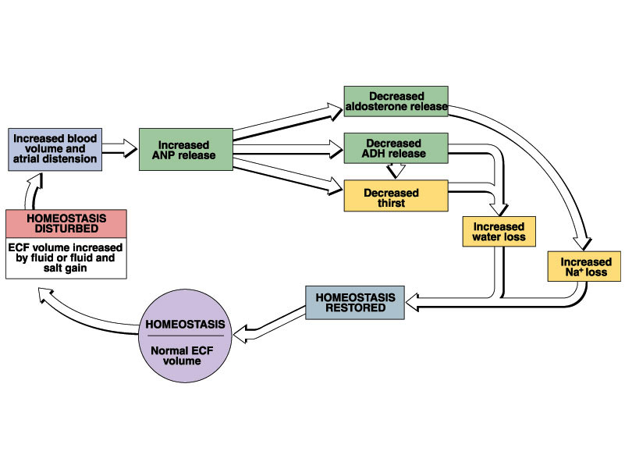

Slide 11
Changes to Sodium Balance
Electrolyte | Cause | Symptoms
Hyponatremia Low Sodium (<130 mEq/l) Normal Range: (135-142 mEq/l) | Decreased intake Increased loss through vomiting, diarrhea, aldosterone deficiency, Diuretics | Muscular weakness dizziness, headache, hypotension, tachycardia, shock, mental confusion, and coma
Hypernatremia High Sodium (> 150mEq/l) | Dehydration, excessive sodium intake, or excessive sodium in intravenous fluids | Intense thirst, hypertension, edema, agitation, convulsions

Slide 12
Summary of Hormones Involved in Sodium Balance

Slide 13
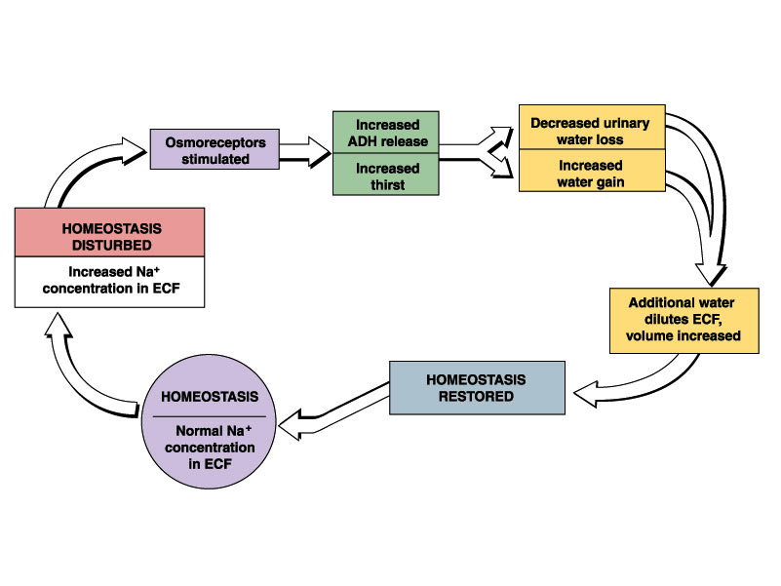

Slide 14
Changes in Chloride Balance
Electrolyte | Causes | Symptoms
Hypochloremia Low Chloride (<95mEq/l) Normal Range (100 – 108 mEq/l) | Excessive vomiting, overhydration, aldosterone deficiency, congestive heart failure | Muscle spasms, metabolic alkalosis, hypotension, muscle tetany, and shallow respiration
Hyperchloremia High Chloride (>112 mEq/l) | Dehydration, excessive intake, severe renal failure, hyperaldosteronism, acidosis | Lethargy, weakness, metabolic acidosis, hyperventilation

Slide 15
Summary of Hormones Involved in Chloride Balance

Slide 16
Changes to Potassium Balance
Electrolyte | Causes | Symptoms
Hypokalemia Low Potassium (<2 mEq/l) Normal Range: (3.8 – 5.0 mEq/l) | Excessive loss through vomiting and diarrhea, decreased intake, hyperaldosteronism, kidney disease | Muscle fatigue and flaccid paralysis, mental confusion, polyuria, shallow respirations, arrhythmias
Hyperkalemia High Potassium (>8 mEq/l) | Excessive intake, renal failure, aldosterone deficiency | Irritability, nausea, vomiting, diarrhea, muscular weakness, ventricular fibrillation

Slide 17
Summary of Hormones Involved in Potassium Balance

Slide 18
Changes in Calcium Balance
Electrolyte | Causes | Symptoms
Hypocalcemia Low Calcium (<4 mEq/l) Normal Range: 4.5 – 5.3 mEq/l) | Hypoparathyroidism, increased loss, decreased intake, elevated phosphate | Numbness and tingling of fingers, hyperactive reflexes, muscle tetany, bone fractures, laryngeal muscle spasms that lead to asphyxiation
Hypercalcemia High Calcium (>11 mEq/l) | Hyperparathyroidism, excessive vitamin D, Paget’s disease | Lethargy, weakness, anorexia, nausea, vomiting, polyuria, itching, bone pain, depression, confusion, and coma

Slide 19
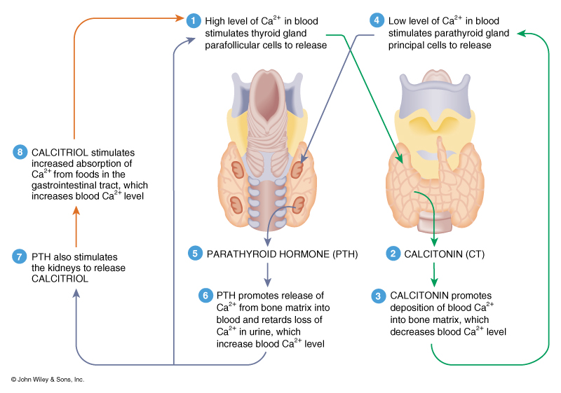
Summary of Hormones Involved in Calcium Balance

Slide 20
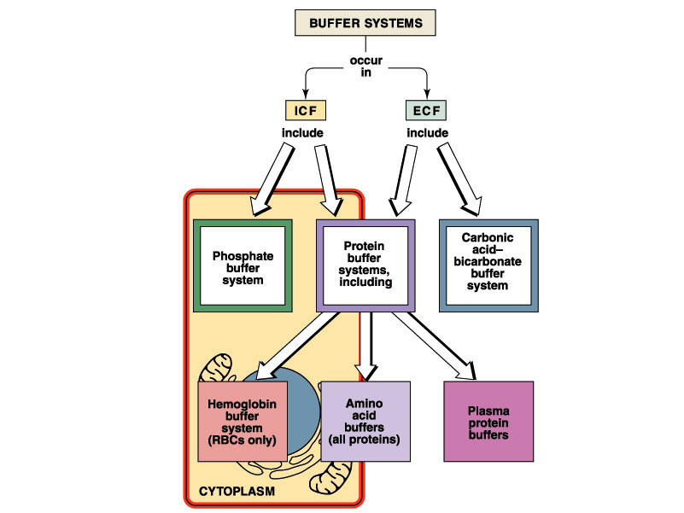
Maintaining Body pH Balance

Slide 21
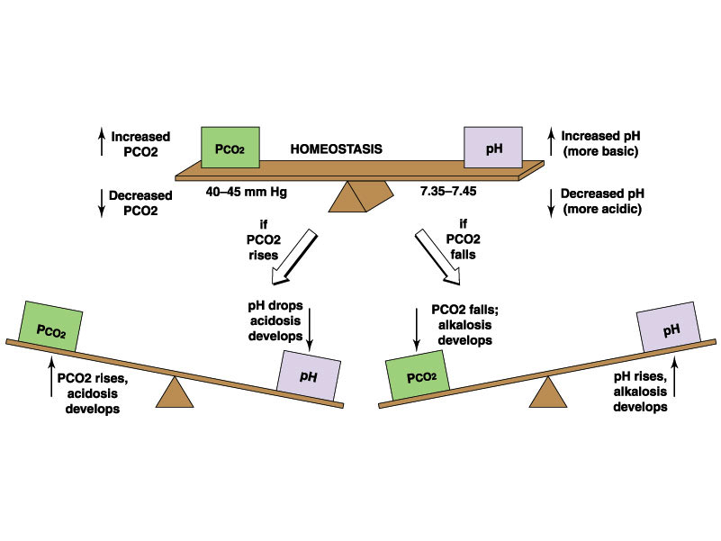

Slide 22
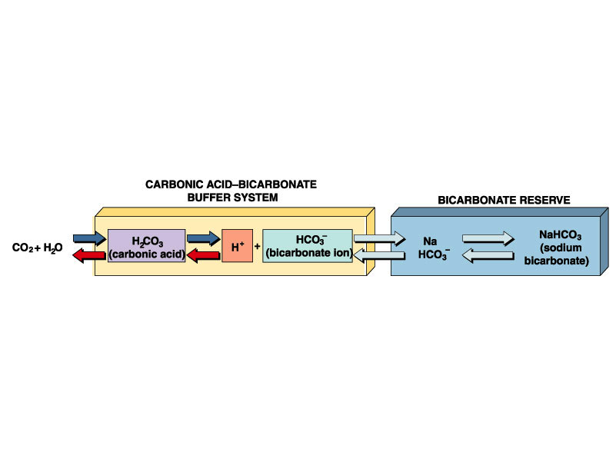

Slide 23
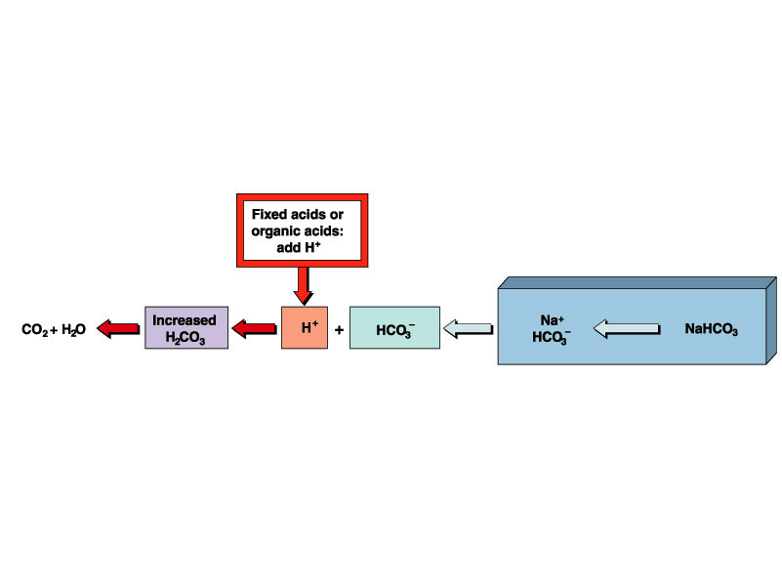

Slide 24
Changes to pH Balance - Acidosis
Condition | Definition | Causes | Compensation
Respiratory | Acidemia Decreased Blood pH (< 7.35) Normal Range 7.35 to 7.45 | Hypoventilation due to emphysema, pulmonary edema, air obstructions | Renal: Increased excretion of H+, increased reabsorption of HCO3-PCO2 will be high (>28mEq/l) Normal Range 24-28mEq/l
Metabolic | Acidemia Decreased Blood pH (< 7.35) | Loss of HCO3- diarrhea, ketosis, renal dysfunction | Respiratory: Hyperventilation will decrease PCO2: HCO3- will be lowered (<24mEq/l)

Slide 25
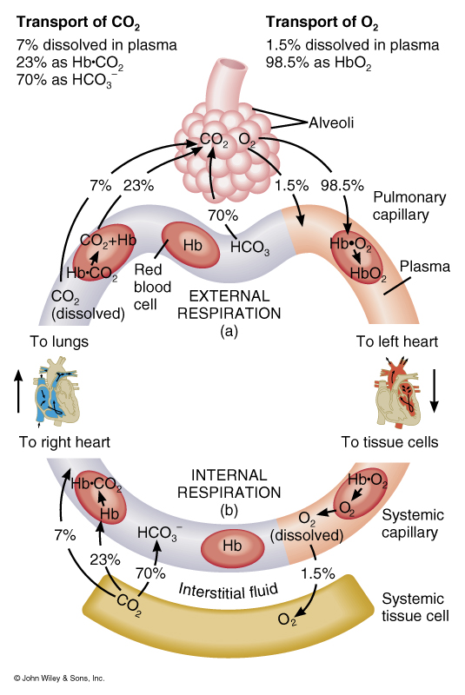
Summary of Systems Involved in pH Balance

Slide 26
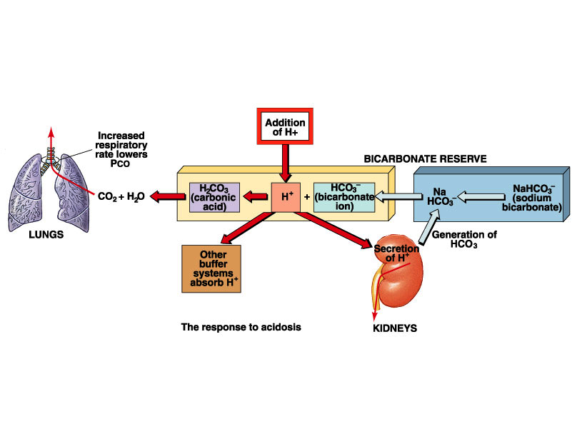

Slide 27
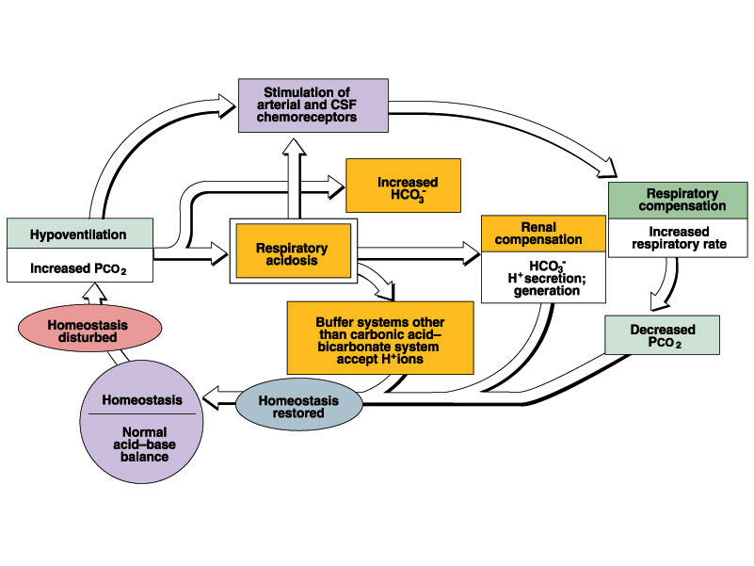

Slide 28
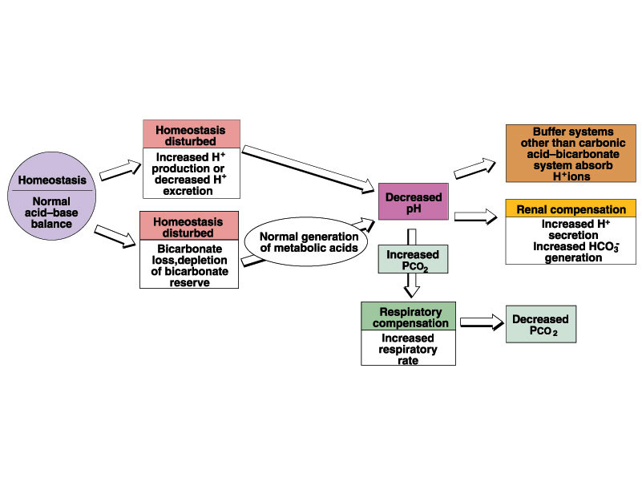

Slide 29
Changes to pH Balance - Alkalosis
Condition | Definition | Causes | Compensation
Respiratory | Hypocapnia Increased Blood pH (>7.45) | Hyperventilationdue to oxygen deficiency, pulmonary disease, anxiety, CVA, aspirin overdose | Renal: decreased excretion of H+, decreased reabsorption of HCO3- PCO2 - (<40mmHg) HCO3- (<24mEq/l)
Metabolic | Increased HCO3- Increased Blood pH (>7.45) | Loss of H+ due to vomiting, gastric suctioning | Respiratory: Hypoventilation HCO3- will be high

Slide 30
Summary of Systems Involved in pH Balance

Slide 31
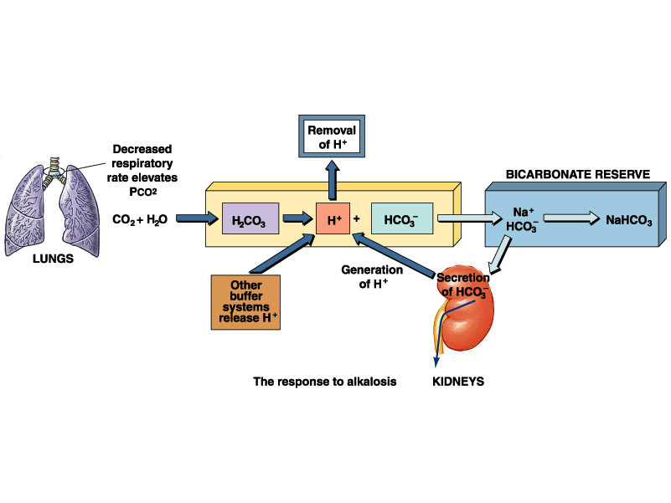

Slide 32
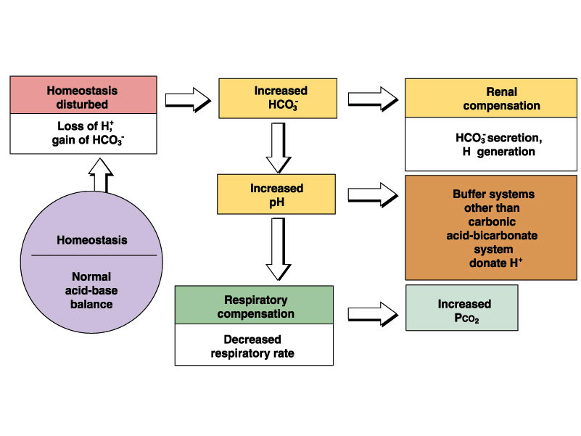

Slide 33
